Slide 1
Chapter 5 Objectives
The CCNA Topics Covered in this chapter include:
  What is VTP?
  VTP Operation
  VTP modes
  VTP Pruning
  Configuration and verification of VTP

Slide 2
VLAN Trunk Protocol (VTP)
Purpose: to manage all configured VLANs across a switch internetwork & maintain consistency
  Allows an administrator to add, delete, & rename VLANs
  A messaging system that advertises VLAN configuration information
  Maintains VLAN configuration consistency throughout a common administrative domain
  Sends advertisements on trunk ports only

Slide 3
VLAN Trunking Protocol (VTP)
Benefits of VTP
  Consistent VLAN configuration across all switches in the network
  Accurate tracking and monitoring of VLANs
  Dynamic reporting of added VLANs to all switches in the VTP domain

Slide 4
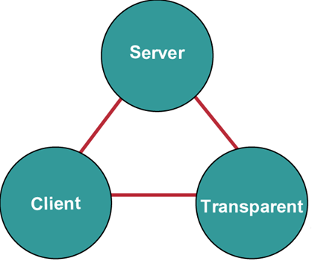
VTP Modes
Creates VLANs
Modifies VLANs
Deletes VLANs
Sends/forwards
advertisements
Synchronizes
Saved in NVRAM
Creates VLANs
Modifies VLANs
Deletes VLANs
Forwards
advertisements
Does not
synchronize
Saved in NVRAM
Forwards
advertisements
Synchronizes
Not saved in
NVRAM

Slide 5
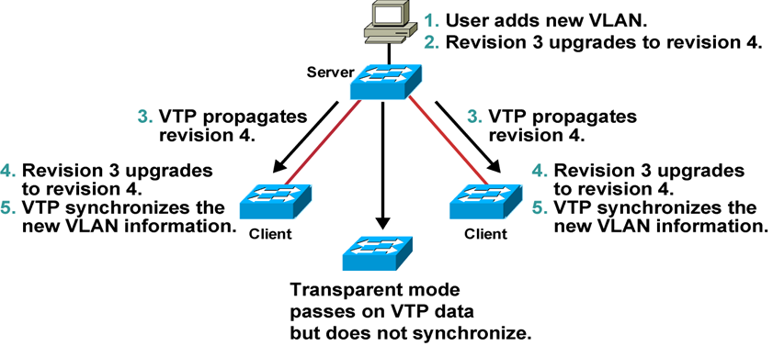
VTP Operation
  VTP advertisements are sent as multicast frames.
  VTP servers and clients are synchronized to the latest update identified revision number.
  VTP advertisements are sent every 5 minutes or when there is a change.

Slide 6
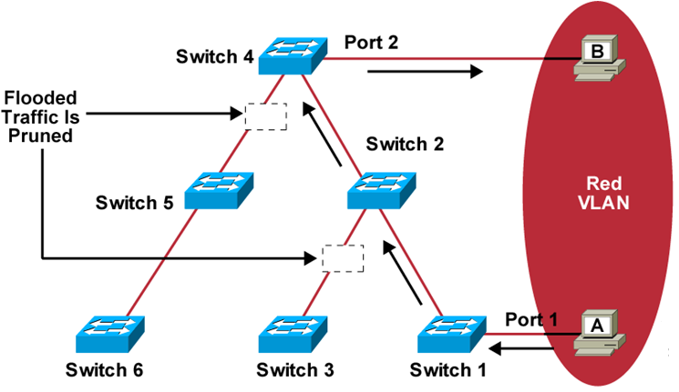
VTP Pruning
  Increases available bandwidth by reducing unnecessary flooded traffic
  Example: Station A sends broadcast, and broadcast is flooded only toward any switch with ports assigned to the red VLAN

Slide 7
VTP Configuration Guidelines
  Configure the following:
    VTP domain name
    VTP mode (server mode is the default)
    VTP pruning
    VTP password
    Switch(config)#vtp mode server
    Switch(config)#vtp domain gates
    SwitchA#sh vtp status

Slide 8
Verifying the VTP Configuration
Switch#show vtp status
Switch#show vtp status
VTP Version : 2
Configuration Revision : 247
Maximum VLANs supported locally : 1005
Number of existing VLANs : 33
VTP Operating Mode : Client
VTP Domain Name : Lab_Network
VTP Pruning Mode : Enabled
VTP V2 Mode : Disabled
VTP Traps Generation : Disabled
MD5 digest : 0x45 0x52 0xB6 0xFD 0x63 0xC8 0x49 0x80
Configuration last modified by 0.0.0.0 at 8-12-99 15:04:49
Switch#

Slide 9
Verifying the VTP Configuration (Cont.)
Switch#show vtp counters
Switch#show vtp counters
VTP statistics:
Summary advertisements received : 7
Subset advertisements received : 5
Request advertisements received : 0
Summary advertisements transmitted : 997
Subset advertisements transmitted : 13
Request advertisements transmitted : 3
Number of config revision errors : 0
Number of config digest errors : 0
Number of V1 summary errors : 0
VTP pruning statistics:
Trunk Join Transmitted Join Received Summary advts received from
non-pruning-capable device
---------------- ---------------- ---------------- ---------------------------
Fa5/8 43071 42766 5

